Slide 1
ASIA PACIFIC COLLEGE ONLINE PRE-REGISTRATION SYSTEM
ANGELICA RUIZ
Project Manager
JAIRUS ROGUEL
Project Developer
DIEGO GLORIA
Project Analyst

Slide 2
Project context
Integrated with the FLAVIO system of Asia Pacific College (APC)
Solely used by the APC community
Eliminates inconveniences
Students log in with their FLAVIO accounts
The system has rules/parameters for validating requests of students
Student’s request passed all rules/parameters => Subjects are added to
their load
Conflict with the rules/parameters => Request is sent to an adviser
Notes:
The online pre-registration system project will be integrated with the FLAVIO system of Asia Pacific College (APC)
Solely used by the APC community
Eliminates inconveniences (e.g. going to different places inside school to successfully pre-register)
With the use of the system, adding of subjects is taken into the next level. It eliminates the inconvenience of going to different places inside school to successfully pre-register
To access the pre-registration, students must first log in to their FLAVIO accounts
Students input subjects they would like to add and to be sent to the system as a request. The system sends it to the adviser, then approves or disapproves the request. After approving, the system updates your registrar form

Slide 3
Purpose and description
Current pre-registration system in APC: Manual
Proposed Project: Online Pre-registration System
Focus Area: Satisfaction and needs of students
Eliminates problems and maximizes resources
Integrated with FLAVIO and can be accessed through Internet in https://www.apc.edu.ph/flavio/inquiry/Login.php
Provides easier accessibility for students and convenience
Eliminates conflicts like in special cases, waiting time for the adviser and the inconvenience of going to offices just to pre-register

Slide 4
Purpose and description
Schedules would still be followed (usually after midterms)
Main use/purpose: To add subjects
Students input the Subject Code, Subject Description, Section and Units
Added subjects are listed then submitted to the system as a request
The system validates subjects if it is allowable for the student
If there are conflicts, the system directs the requests to the advisers and they approve or disapprove. If there are no conflicts, students can have the subject immediately
Approval or disapproval of advisers would be submitted to the system and directed to the student and view their Registration Form to check
Notes:
Schedules would still be followed (usually after midterms)
Adding of subjects is the main use of the pre-registration system
In order to add, students must input the Subject Code, Subject Description, Section and Units (just like in the current form)
Subjects added by students would be placed into a list then submitted to the system as a request
The system checks the student’s subject if the requested subjects does not conflict with the student’s flowchart and pre-requisites
If there are conflicts, the system directs the requests to the advisers and they approve or disapprove. If there are no conflicts, students can have the subject immediately
Approval or disapproval of advisers would be submitted to the system and directed to the student and view their Registration Form to check

Slide 5
objectives
To understand the flow of the current pre-registration process
To build a design and a prototype of the online pre-registration system
To collect data from students about their feedback on the pre-registration system
To look for sample algorithms that may serve as a basis for working on the project
To provide convenience and satisfy the students, advisers and APC Community

Slide 6
Scope and limitations
Solely used by the APC Community
Integrated with the FLAVIO System for easy access and will require authentication
Adding of subjects will be the project’s main feature
Crashing of system due to error in the code will be examined by the group
Problems like overloading of database will be examined by the ITRO staff
Special cases (ex.: accreditation of subjects, advance taking of subjects, adding a subject even if maximum units are already met, etc.) would be settled manually for it requires human interaction in order to analyze more whether it is allowable

Slide 7
Technical background
Framework used: Cobalt mark IV - build 20160307
Download: XAMPP Apache and MySQL and access the localhost.
The FLAVIO System of APC uses Cobalt as its framework, thus the project is obliged to use the framework also because the Online Pre-Registration System is to be integrated with FLAVIO.
When implemented, students can access https://www.apc.edu.ph/flavio/inquiry/Login.php using their existing accounts then view the “Pre-Registration” which is a new system added in FLAVIO.

Slide 8
Design and methodology
Cobalt framework and XAMPP is used. In XAMPP Control Panel, Apache and MySQL module is started then access the localhost at preferred browser, for the project, Google Chrome is used.
For the project, there are two main users which are program directors (administrator) and students (user). The student an add subjects while the administrator can edit other tables like the subjects offered and schedules.
The system can filter or validate requests based on the rules/parameters it has
When a student’s request passed all parameters, they can successfully add the subject to their load
Method of choosing students for a specific subject: First come, first serve
There is a timestamp once the request has been sent

Slide 9
Related literature ATENEO INTEGRATED Student INFORMATION SYSTEM (AISIS)
AISIS is the portal for Ateneo students, faculty and staff. It officially enrolls the students and view school information including their IPS, grades, class schedules and the like. Students may also eventually enlist using AISIS Online. Ateneo faculty and staff with access to AISIS, on the other hand, may submit grades and access their class schedules from outside the campus.
AISIS Online provides an Online Enlistment service that would give the students the convenience of modifying their subjects online. One of our project’s objectives is to provide convenience and satisfy the students, advisers and APC Community. With this related literature, we can adopt or implement ideas that we have reviewed in the system and implement it to our proposed system. (Retrieved on August 19, 2016 from http://aisisonline.ateneo.edu/index.php)

Slide 10
Related literature DE LA SALLE UNIVERSITY ANIMO.SYS PORTAL
Animo.sys Portal: An online enrollment system of DLSU
Students must have a My.LaSalle account to access Animo.sys
Inside Animo.sys Portal, students can add classes for the next term
The subjects have different codes that they can encode online. There is a status if the subject they requested is approved. After enrolling, they may claim the Enrollment Assessment Form (EAF) which contains all the subjects they have encoded.
Method of choosing students to a specific subject: First come, first serve
(Retrieved on August 19, 2016 from https://my.dlsu.edu.ph/faq/, http://www.dlsu.edu.ph/offices/registrar/enrollment.asp)
Notes:
Similar features:
Provide course codes for students to know what subjects they want to add.
Both have academic advising for students to be notified whether they can take the subject or not due to different cases like failed pre-requisites, unfinished clearances and unpaid tuition fees.
By having a background of how Animo.sys Portal works, it will be a great basis for creating our proposed project which is Asia Pacific College Online Pre-Registration System.

Slide 11
Related literature UNIVERSITY OF THE PHILIPPINES COMPUTERIZED REGISTRATION SYSTEM (UP CRS)
Students can enlist subjects in the middle of the period. During advanced enlistment students would submit a list of their desired subjects to their respective colleges. The lists are submitted online through the UP CRS.
The UP CRS then processes these list according to the student’s enrollment status. The results are to be printed as the UP Form 5-A. During the registration period, the subjects can be added or dropped from the Form 5-A due to different reasons. Then the different colleges would allocate new slots to those subjects that have been dropped by the students. These slots can be viewed in the UP CRS.
UP CRS add, drop and petition subjects online. The UP CRS can also show available slots to all subjects offered just like what APC has which is the Masters List. The UP CRS would be a great basis on what functionalities our Pre-registration system would have.
Method of choosing students for a specific subject: Randomized
(Retrieved on August 19, 2016 from http://www.eee.upd.edu.ph/academic-programs/enlistment/computerized-registration-system

Slide 12
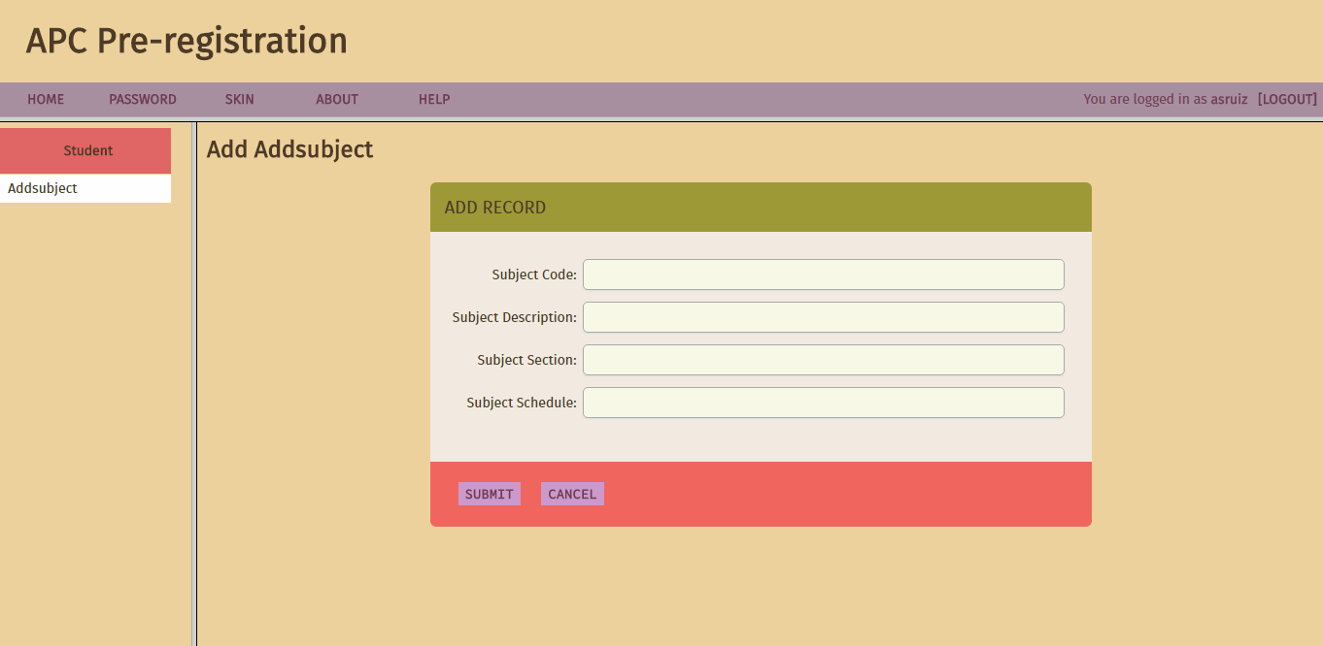
Initial design

Slide 13
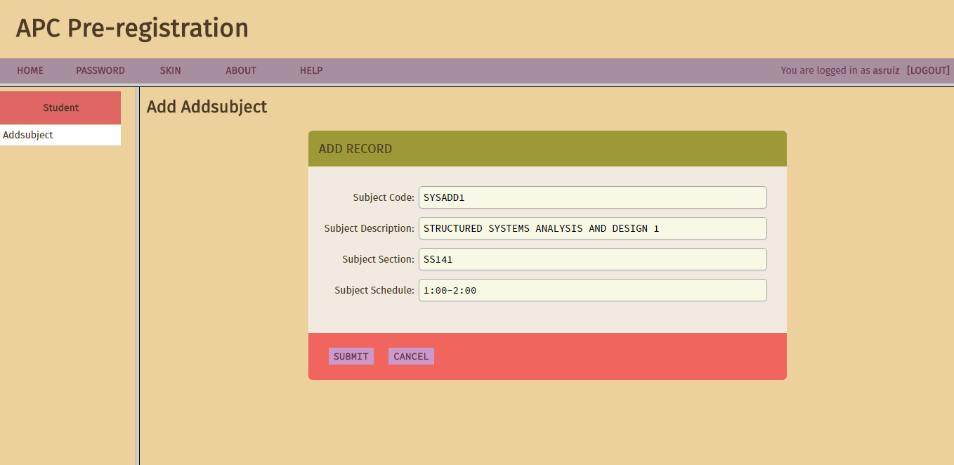
Initial design

Slide 14
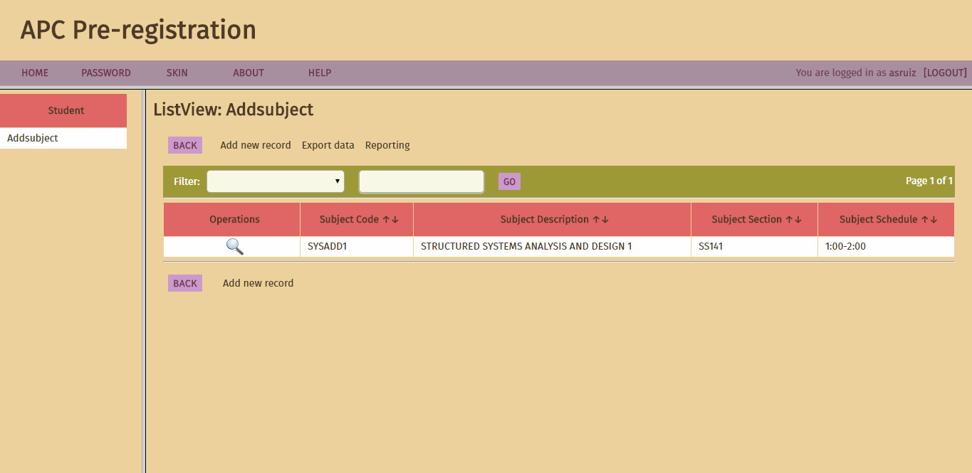
Initial design

Slide 15
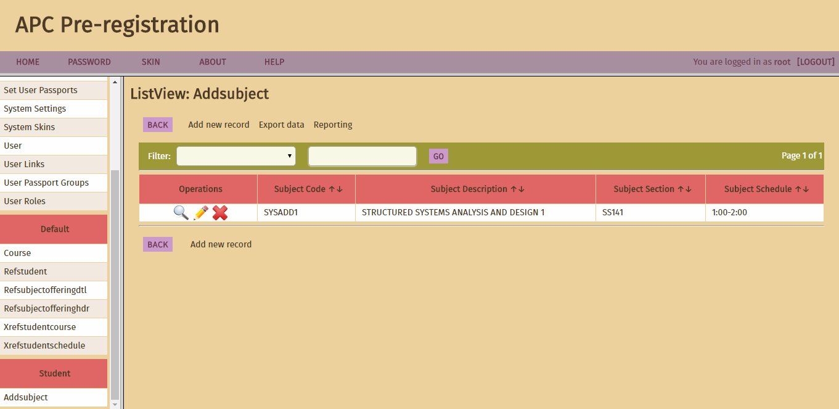
Initial design

Slide 16
STATEMENT OF WORK
PERIOD OF PERFORMANCE
The period of performance for the APC Pre-Registration System will take one year on the beginning of September 2016 to December 2016. All work must be scheduled to complete within this timeframe. Any modifications or extensions will be requested to the designated professor for review and discussion.
PLACE OF PERFORMANCE
The project will be used at Asia Pacific College, as well as its sister schools.
Notes:
Schedules would still be followed (usually after midterms)
Adding of subjects is the main use of the pre-registration system
In order to add, students must input the Subject Code, Subject Description, Section and Units (just like in the current form)
Subjects added by students would be placed into a list then submitted to the system as a request
The system checks the student’s subject if the requested subjects does not conflict with the student’s flowchart and pre-requisites
If there are conflicts, the system directs the requests to the advisers and they approve or disapprove. If there are no conflicts, students can have the subject immediately
Approval or disapproval of advisers would be submitted to the system and directed to the student and view their Registration Form to check

Slide 17
Work requirements
Notes:
Schedules would still be followed (usually after midterms)
Adding of subjects is the main use of the pre-registration system
In order to add, students must input the Subject Code, Subject Description, Section and Units (just like in the current form)
Subjects added by students would be placed into a list then submitted to the system as a request
The system checks the student’s subject if the requested subjects does not conflict with the student’s flowchart and pre-requisites
If there are conflicts, the system directs the requests to the advisers and they approve or disapprove. If there are no conflicts, students can have the subject immediately
Approval or disapproval of advisers would be submitted to the system and directed to the student and view their Registration Form to check

Slide 18
As part of the APC Online Pre-Registration Project, the team will be responsible for performing tasks throughout various stages of this project. The following is a list of these tasks which will result in the successful completion of this project:
Kickoff:
The team will create and present detailed project plan including schedule, WBS, testing plan, implementation plan, training plan, and transition plan
The team will present project plan to the adviser and consultants for review and approval
Design Phase:
Work with adviser and consultants to gather requirements and establish metrics
Create user interface design and database design based on collected requirements
Develop site design proposal review and approval
Present project status reports at weekly meeting
Build Phase:
The team will complete all coding for approved site design
The team will provide advisers and consultant with a detailed testing plan
The team will conduct testing inside Asia Pacific College
The team will resolve any coding and site issues identified in testing
The team will compile a testing report to present to the adviser and consultants for review/approval
Present written status at weekly meeting
Implementation Phase:
The team will implement the newly redesigned project
The team will pass to the ITRO the 24/7 web site support at this point forward until the end of the period of performance
Present written status at weekly meeting
Training Phase:
The team will provide training in accordance with approved training plan provided in the kickoff
Present written status at weekly meeting
Notes:
Schedules would still be followed (usually after midterms)
Adding of subjects is the main use of the pre-registration system
In order to add, students must input the Subject Code, Subject Description, Section and Units (just like in the current form)
Subjects added by students would be placed into a list then submitted to the system as a request
The system checks the student’s subject if the requested subjects does not conflict with the student’s flowchart and pre-requisites
If there are conflicts, the system directs the requests to the advisers and they approve or disapprove. If there are no conflicts, students can have the subject immediately
Approval or disapproval of advisers would be submitted to the system and directed to the student and view their Registration Form to check

Slide 19
Project Handoff/Closure:
The team will provide the adviser and consultants with all documentation in accordance with the approved project plan
The team will present project closure report to adviser and consultants for review and approval
The team will complete the project requirements checklist showing that all project tasks have been completed
The team will conclude 24x7 web support at 11:59pm on the final day of the period of performance
Present written status at weekly meeting
Notes:
Schedules would still be followed (usually after midterms)
Adding of subjects is the main use of the pre-registration system
In order to add, students must input the Subject Code, Subject Description, Section and Units (just like in the current form)
Subjects added by students would be placed into a list then submitted to the system as a request
The system checks the student’s subject if the requested subjects does not conflict with the student’s flowchart and pre-requisites
If there are conflicts, the system directs the requests to the advisers and they approve or disapprove. If there are no conflicts, students can have the subject immediately
Approval or disapproval of advisers would be submitted to the system and directed to the student and view their Registration Form to check

Slide 20
STATEMENT OF WORK
Version | Date | Author | Change Description
1.0 | 9/27/2016 | Angelica Ruiz | Document created
2.0 | 10/03/2016 | Diego Gloria | Updated Revisions on Onenote, Wiki Approval of Adviser Request Bluemix accounts
3.0 | 10/09/2016 | Jairus Roguel | Started to set-up bluemix and phpmyadmin
4.0 | 10/16/2016 | Angelica Ruiz | Updated Revisions on Wiki Approval of Consultants Request Presentation on first draft of Statement of work & Vision and Scope
4.1 | 10/22/2016 | Diego Gloria | Changed Dates in milestone deliverables over last period due to typographical errors (Milestone: Consultant Requests) Updated Gathering of manual pre-registration system rules
Notes:
Schedules would still be followed (usually after midterms)
Adding of subjects is the main use of the pre-registration system
In order to add, students must input the Subject Code, Subject Description, Section and Units (just like in the current form)
Subjects added by students would be placed into a list then submitted to the system as a request
The system checks the student’s subject if the requested subjects does not conflict with the student’s flowchart and pre-requisites
If there are conflicts, the system directs the requests to the advisers and they approve or disapprove. If there are no conflicts, students can have the subject immediately
Approval or disapproval of advisers would be submitted to the system and directed to the student and view their Registration Form to check

Slide 21
Other requirements
There is a security requirement for the system because the students’ data must always be protected. Also, the ITRO will handle all crashes in the database and servers of the school. The team will have full access to the system for maintenance and improvements. The system will be programmed and tested inside Asia Pacific College, but if needed, the team may meet up on a certain venue to work on the system.
Notes:
Schedules would still be followed (usually after midterms)
Adding of subjects is the main use of the pre-registration system
In order to add, students must input the Subject Code, Subject Description, Section and Units (just like in the current form)
Subjects added by students would be placed into a list then submitted to the system as a request
The system checks the student’s subject if the requested subjects does not conflict with the student’s flowchart and pre-requisites
If there are conflicts, the system directs the requests to the advisers and they approve or disapprove. If there are no conflicts, students can have the subject immediately
Approval or disapproval of advisers would be submitted to the system and directed to the student and view their Registration Form to check

Slide 22
Vision and scope
Notes:
Schedules would still be followed (usually after midterms)
Adding of subjects is the main use of the pre-registration system
In order to add, students must input the Subject Code, Subject Description, Section and Units (just like in the current form)
Subjects added by students would be placed into a list then submitted to the system as a request
The system checks the student’s subject if the requested subjects does not conflict with the student’s flowchart and pre-requisites
If there are conflicts, the system directs the requests to the advisers and they approve or disapprove. If there are no conflicts, students can have the subject immediately
Approval or disapproval of advisers would be submitted to the system and directed to the student and view their Registration Form to check

Slide 23
Vision and scope
Business Opportunity
Students and even faculty staff encounter problems in the manual pre-registration system like placing a wrong subject to a student’s load and not having enough knowledge about the rules in pre-registering. With the APC Online Pre-Registration System, students and faculty alike can have an efficient and convenient experience in the pre-registration process.
Business Objectives and Success Criteria
To understand the flow of the current pre-registration process
To build a prototype of the online pre-registration system
To collect data from students about their feedback on the pre-registration system
To look for sample algorithms that may serve as a basis for working on the project
To provide convenience and satisfy the students, advisers and APC Community
Notes:
Schedules would still be followed (usually after midterms)
Adding of subjects is the main use of the pre-registration system
In order to add, students must input the Subject Code, Subject Description, Section and Units (just like in the current form)
Subjects added by students would be placed into a list then submitted to the system as a request
The system checks the student’s subject if the requested subjects does not conflict with the student’s flowchart and pre-requisites
If there are conflicts, the system directs the requests to the advisers and they approve or disapprove. If there are no conflicts, students can have the subject immediately
Approval or disapproval of advisers would be submitted to the system and directed to the student and view their Registration Form to check

Slide 24
Customer or Market Needs
Asia Pacific College students usually encounter inconsistencies in adding a subject to their load that may result to conflict in schedules. Thus they need a faster and convenient way of adding a subject because of the problems encountered during every pre-registration period. Because of that, a more efficient pre-registration system is highly needed to satisfy the following needs:
1) Faster pre-registration process
2) Reliable pre-registration system (because of conflicts)
3) Easier access to the system
With the APC Online Pre-Registration System, there would be:
1) Easy navigation
2) User-friendly Interface
3) Chance for users to experience adding their own subjects
Notes:
Schedules would still be followed (usually after midterms)
Adding of subjects is the main use of the pre-registration system
In order to add, students must input the Subject Code, Subject Description, Section and Units (just like in the current form)
Subjects added by students would be placed into a list then submitted to the system as a request
The system checks the student’s subject if the requested subjects does not conflict with the student’s flowchart and pre-requisites
If there are conflicts, the system directs the requests to the advisers and they approve or disapprove. If there are no conflicts, students can have the subject immediately
Approval or disapproval of advisers would be submitted to the system and directed to the student and view their Registration Form to check

Slide 25
Customer or Market Needs
Many risks arise in this project such as implementation issues, miscommunications, and timing problems. The respective actions to the risks are to be on time when it comes to creating and developing the project, to take responsibility to the given tasks, to communicate well with the team and to prioritize the project.
Notes:
Schedules would still be followed (usually after midterms)
Adding of subjects is the main use of the pre-registration system
In order to add, students must input the Subject Code, Subject Description, Section and Units (just like in the current form)
Subjects added by students would be placed into a list then submitted to the system as a request
The system checks the student’s subject if the requested subjects does not conflict with the student’s flowchart and pre-requisites
If there are conflicts, the system directs the requests to the advisers and they approve or disapprove. If there are no conflicts, students can have the subject immediately
Approval or disapproval of advisers would be submitted to the system and directed to the student and view their Registration Form to check

Slide 26
Vision of the solution
The long-term vision of the system is to provide comfort and convenience for the Asia Pacific College (APC) community by simply integrating our Online Pre-Registration System to the FLAVIO system for easy access.
Vision Statement
The purpose and intent of our system is to lessen the inconvenience of the APC community by making the manual Pre-Registration System online. If the system will be implemented, students will no longer need to fall in line in the fourth floor which causes inconvenience especially for the professors who are assigned to advise. The school’s online services will better serve the APC community and its potential will increase.
Major Features
Modifying of subjects – students can add or drop subjects in order to organize their schedule
Validation of requests – the system checks if the request of student can be granted
Notes:
Schedules would still be followed (usually after midterms)
Adding of subjects is the main use of the pre-registration system
In order to add, students must input the Subject Code, Subject Description, Section and Units (just like in the current form)
Subjects added by students would be placed into a list then submitted to the system as a request
The system checks the student’s subject if the requested subjects does not conflict with the student’s flowchart and pre-requisites
If there are conflicts, the system directs the requests to the advisers and they approve or disapprove. If there are no conflicts, students can have the subject immediately
Approval or disapproval of advisers would be submitted to the system and directed to the student and view their Registration Form to check

Slide 27
Scope and limitations
The project includes the online pre-registration, adding of subjects and viewing of subjects enrolled and offered in Asia Pacific College for the students of APC. Also, it will not cover special cases (accreditation of subjects taken from another college/university, etc.) because it would need to be handled by the Registrar and Program Directors.
Scope of Initial Release
The projects’ initial release would include adding of subjects and viewing of enrolled subjects and subjects offered by APC. These would be the main features because the developers believe that these features are the most important.
Scope of Subsequent Releases
In the following releases, this project would have the feature of dropping and requesting of subjects.
Limitations and Exclusions
Setting an appointment for special cases, subject recommendations, online petition of subjects and notifications would not be included in any version of the project.
Notes:
Schedules would still be followed (usually after midterms)
Adding of subjects is the main use of the pre-registration system
In order to add, students must input the Subject Code, Subject Description, Section and Units (just like in the current form)
Subjects added by students would be placed into a list then submitted to the system as a request
The system checks the student’s subject if the requested subjects does not conflict with the student’s flowchart and pre-requisites
If there are conflicts, the system directs the requests to the advisers and they approve or disapprove. If there are no conflicts, students can have the subject immediately
Approval or disapproval of advisers would be submitted to the system and directed to the student and view their Registration Form to check

Slide 28
Business context
Stakeholder Profiles
Asia Pacific College students
Reduced work
Improved productivity
Automation of previously manual tasks
Ability to perform entirely new tasks or functions
Improved usability or reduced frustration level compared to current applications
Asia Pacific College Faculty
Cost Savings
Improved Productivity
Notes:
Schedules would still be followed (usually after midterms)
Adding of subjects is the main use of the pre-registration system
In order to add, students must input the Subject Code, Subject Description, Section and Units (just like in the current form)
Subjects added by students would be placed into a list then submitted to the system as a request
The system checks the student’s subject if the requested subjects does not conflict with the student’s flowchart and pre-requisites
If there are conflicts, the system directs the requests to the advisers and they approve or disapprove. If there are no conflicts, students can have the subject immediately
Approval or disapproval of advisers would be submitted to the system and directed to the student and view their Registration Form to check

Slide 29
Business context
Stakeholder | Major Value | Attitudes | Major Interests | Constraints
APC Students | Automation of previously manual tasks | -- | -- | --
APC Faculty | Less workload | highly receptive, but expect high usability | automatic error correction; ease of use; high reliability | must run on low-end workstations
Notes:
Schedules would still be followed (usually after midterms)
Adding of subjects is the main use of the pre-registration system
In order to add, students must input the Subject Code, Subject Description, Section and Units (just like in the current form)
Subjects added by students would be placed into a list then submitted to the system as a request
The system checks the student’s subject if the requested subjects does not conflict with the student’s flowchart and pre-requisites
If there are conflicts, the system directs the requests to the advisers and they approve or disapprove. If there are no conflicts, students can have the subject immediately
Approval or disapproval of advisers would be submitted to the system and directed to the student and view their Registration Form to check

Slide 30
Project priorities
Project Priorities
Dimension | Driver (state objective) | Constraint (state limits) | Degree of Freedom (state allowable range)
Schedule | release 1.0 to be available by 12/20/16
Staff |  | Maximum team size: 1 project manager + 1 project developer + 1 project analyst
Quality |  |  | 90-95% of user acceptance tests must pass for release 1.0, 95-98% for release 1.1
Features |  |  | 70-80% of high priority features must be included in release 1.0
Cost |  |  | budget overrun up to 15% acceptable without executive review
Notes:
Schedules would still be followed (usually after midterms)
Adding of subjects is the main use of the pre-registration system
In order to add, students must input the Subject Code, Subject Description, Section and Units (just like in the current form)
Subjects added by students would be placed into a list then submitted to the system as a request
The system checks the student’s subject if the requested subjects does not conflict with the student’s flowchart and pre-requisites
If there are conflicts, the system directs the requests to the advisers and they approve or disapprove. If there are no conflicts, students can have the subject immediately
Approval or disapproval of advisers would be submitted to the system and directed to the student and view their Registration Form to check

Slide 31
Operating environment
The users will be Asia Pacific College students and faculty located in the Philippines, also if possible, it can also be used by the sister schools.
The system will be accessed during the pre-registration period.
The data generated will come from the students and faculty inputs.
Interruptions like database overloading or crashing will be handled by the ITRO.
Students must have a FLAVIO account to access the system.
Notes:
Schedules would still be followed (usually after midterms)
Adding of subjects is the main use of the pre-registration system
In order to add, students must input the Subject Code, Subject Description, Section and Units (just like in the current form)
Subjects added by students would be placed into a list then submitted to the system as a request
The system checks the student’s subject if the requested subjects does not conflict with the student’s flowchart and pre-requisites
If there are conflicts, the system directs the requests to the advisers and they approve or disapprove. If there are no conflicts, students can have the subject immediately
Approval or disapproval of advisers would be submitted to the system and directed to the student and view their Registration Form to check

Slide 32
conclusion
UPDATES:
-- Rules
No advancing of subjects
Pre-requisites
Max # of units: (21 for regular students, 24 for graduating or if subject to be added is NATSER or PE)
-- Cobalt Training
NEXT:
-- Design
GUI
Database
Notes:
Schedules would still be followed (usually after midterms)
Adding of subjects is the main use of the pre-registration system
In order to add, students must input the Subject Code, Subject Description, Section and Units (just like in the current form)
Subjects added by students would be placed into a list then submitted to the system as a request
The system checks the student’s subject if the requested subjects does not conflict with the student’s flowchart and pre-requisites
If there are conflicts, the system directs the requests to the advisers and they approve or disapprove. If there are no conflicts, students can have the subject immediately
Approval or disapproval of advisers would be submitted to the system and directed to the student and view their Registration Form to check

